Slide 1
Lecture 5
Final Drive Gears and Bearings

Slide 2
To-do-list
Define final drive
Define differential unit
Define axle shaft
Describe final drive, differential unit and axle shaft
Describe maintenance procedure for final drive, differential unit and axle shaft
Perform maintenance on the final drive, differential unit and axle shaft

Slide 3
Final Drive
Final Drive is a set of gears that transmit torque from transmission to the differential and it consists of pinion gear and ring gear.
Functions of Final Drive
To change the direction of the power transmitted by the drive shaft through 90 degrees to the driving axles.
It provides a fixed gear reduction between the speed of the drive shaft and the axle driving the wheels.

Slide 4
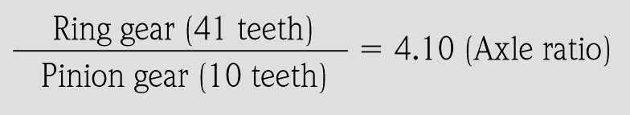
Final Drive
Reduction or gear ratio of the final drive is determined by dividing the number of teeth on the ring gear by the number of teeth on the pinion gear.
Example;-

Slide 5
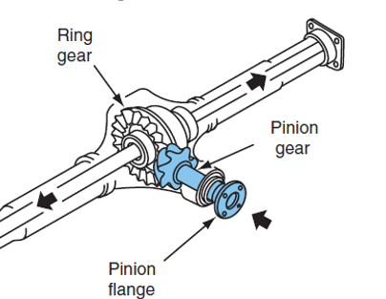
Final Drive
Components of Final Drive
It consists of
Pinion gear, connected to the drive shaft, and
Ring gear (crown wheel) that is bolted or riveted to the differential carrier.

Slide 6
Final Drive
Gears used in final drive are
Spiral Bevel Gear
Hypoid Gear

Slide 7
Final Drive
Spiral Bevel Gear
Spiral bevel gears have curved gear teeth with the pinion and ring gear on the same center line.
This type of final drive is used extensively in trucks and occasionally in older automobiles.
This design allows for constant contact between the ring gear and pinion.
It also necessitates the use of heavy grade lubricants.

Slide 8
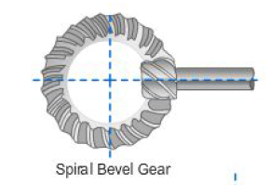

Slide 9
Final Drive
Hypoid Gear
The hypoid gear final drive is an improvement or variation of the spiral bevel design and is commonly used in light and medium trucks and all domestic rear wheel drive automobiles.
The pinion meshes with the ring gear below the center line and is at a slight angle (less than 90 degrees)
This angle and the use of heavier (larger) teeth permit an increased amount of power to be transmitted while the size of the ring gear and housing remain constant.

Slide 10
Final Drive
Hypoid Gear cont..
The tooth design is similar to the spiral bevel but includes some of the characteristics of the worm gear.
This permits the reduced drive angle. The hypoid gear teeth have a more pronounced curve and steeper angle, resulting in larger tooth areas and more teeth to be in contact at the same time.
With more than one gear tooth in contact, a hypoid design increases gear life and reduces gear noise.
The wiping action of the teeth causes heavy tooth pressure that requires the use of heavy grade lubricants.

Slide 11
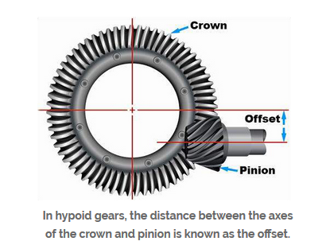
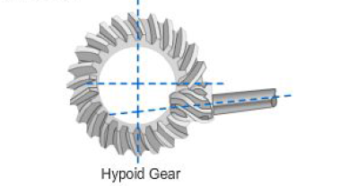

Slide 12
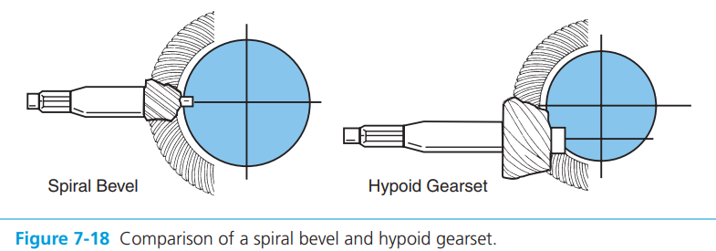

Slide 13
Final Drive
Transaxle Final Drive
The differential operates basically the same as in a RWD axle
There is no 90‐degree change in direction
The drive pinion is connected to the Transmission output shaft
The ring gear is attached to the differential case

Slide 15
Differential Unit
A differential is a set of gears that divides torque evenly between two drive wheels.
Functions of differential
To allow the wheels to turn at different speeds while cornering
To send power from final drive to axle shaft
Components of Differential
It consists of
Side(sun) gear
Pinion gear
Differential cage

Slide 16
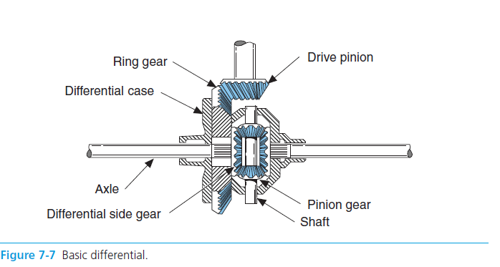

Slide 17
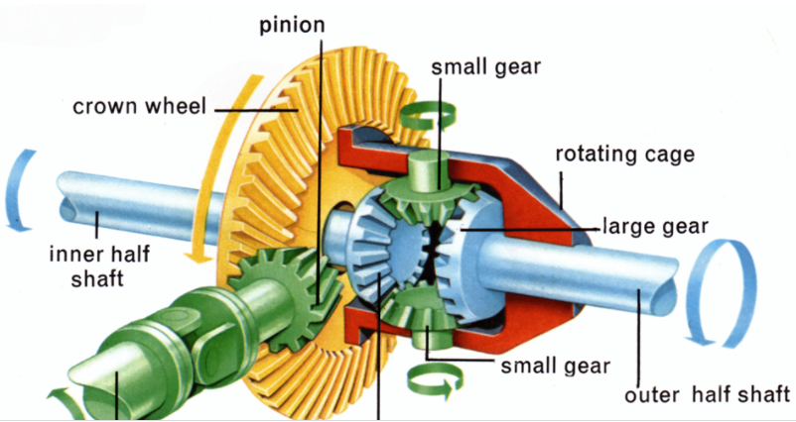

Slide 18
Differential Unit
Differential Actions
The rear wheels of a vehicle do not always turn at the same speed.
When the vehicle is turning or when tire diameters differ slightly, the rear wheels must rotate at different speeds.
If there were a solid connection between each axle and the differential case, the tires would tend to slide and wear whenever the driver turned the steering wheel of the vehicle.
A differential is designed to prevent this problem

Slide 19
Differential Unit
a. Driving Straight Ahead
The ring gear, differential case, differential pinion gears, and differential side gears turn as a single unit.
The two differential pinion gears do NOT rotate on the pinion shaft, because they exert equal force on the side gears.
The side gears turn at the same speed as the ring gear, causing both rear wheels to turn at the same speed.

Slide 21
Differential Unit
b. Turning Corners
When the vehicle begins to round a curve, the differential pinion gears rotate on the pinion shaft.
This occurs because the pinion gears must walk around the slower turning differential side gear.
Therefore, the pinion gears carry additional rotary motion to the faster turning outer wheel on the turn.
The percentage of speed that is removed from one wheel is given to the other

Slide 22
Differential Unit
b. Turning Corners cont..
Differential speed is considered to be 100 percent.
The rotating action of the pinion gears carries 90 percent of this speed to the slowing mover inner wheel and sends 110 percent of the speed to the faster rotating outer wheel.
This action allows the vehicle to make the turn without sliding or squealing the wheels.

Slide 25
Differential Unit
NOTE
A standard differential can be described as a torque equalizer.
This is because the same torque is always provided to each wheel, even if they are revolving at different speeds.
At greater speeds, more power is applied to the wheel, so the torque remains the same.

Slide 26
Differential Unit
Types of Differential
Open differential (OD) is the most common type
Limited slip differential (LSD)
Locking differential (locker) is able to lock the two drive wheels on an axle together
Spool differential is an open differential in which the axles have been mechanically fastened together

Slide 27
Differential Unit
1. Open Differential
Gears and axle shafts arrangement makes up the open type differential, and is the most common type of automotive differential from which more complicated systems are derived
It allows the vehicle to go around the corners without dragging the outside wheel.
However, power is transmitted to the wheel with least amount of traction, if that wheel is on ice or other slippery surfaces the vehicle will not move forward and the wheel with the power will simply spin

Slide 28
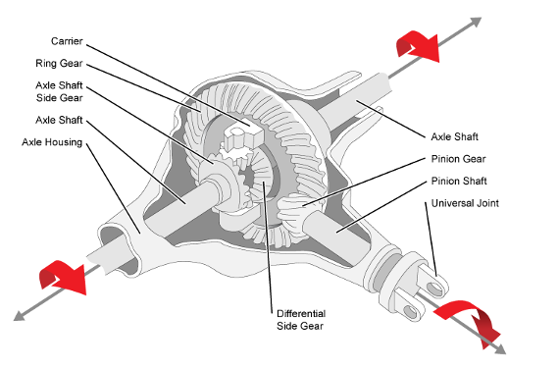

Slide 29
Differential Unit
2. locking differential (locker)
It is essentially an open differential with the ability to be locked in place to create a fixed axle instead of an independent one.
This can happen manually or electronically depending on technology in the vehicle.
The locking differential limits the two wheels on an axle to rotate at the same speed
Found on some vehicles, primarily those that go off road.
The benefit of a locked differential is, it is able to gain a considerably greater amount of traction than an open differential.

Slide 30
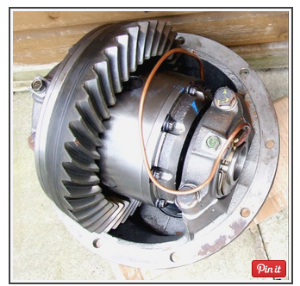

Slide 31
Differential Unit
3. Welded/Spool Differential
Welded differentials are essentially the same as a locked differential, only it has been permanently welded from an open differential into a fixed axle.
This is usually only done in specific circumstances where the characteristics of the locked diff/fixed axle, which makes it easier to keep both wheels spinning simultaneously, are desirable.
For example, competitive driving vehicles.

Slide 32
Differential Unit
3. Welded/Spool Differential cont..
Because they are permanently locked, there is no differential action when the axle goes into a turn.
The benefit is that you’re always supplying power to the axle that has traction.
The problem is that you no longer have full control as you turn your vehicle because both tires will try to spin at the same speed.

Slide 33
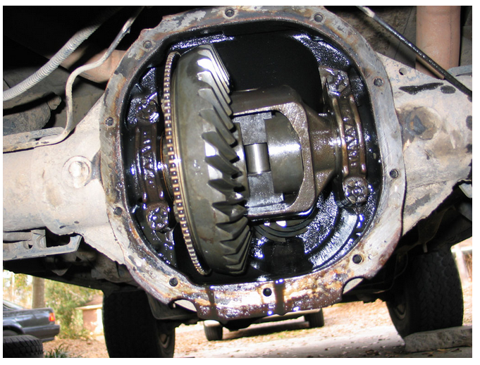

Slide 34
Differential Unit
4. Limited Slip Differentials
The conventional differential delivers the same amount of torque to each rear wheel when both wheels have equal traction.
When one wheel has less traction than the other, for example, when one-wheel slips on ice, the other wheel cannot deliver torque. All turning effort goes to the slipping wheel.
To provide good, even traction even though one wheel is slipping, a limited slip differential is used in many vehicles.

Slide 35
Differential Unit
4. Limited Slip Differentials cont…
It is very similar to the standard unit but has some means of preventing wheel spin and loss of traction.
The standard differential delivers maximum torque to the wheel with minimum traction.
The limited slip differential delivers maximum torque to the wheel with maximum traction.
Other names for a limited slip differential are posi-traction, sure-grip, equal lock, and no-spin

Slide 36
Differential Unit
Types of Limited Slip Differential
Clutch Pack Limited Slip Differential
Cone Clutch Limited Slip Differential

Slide 37
Axle Shaft
An axle shaft is a shaft used to transfer driving torque from the differential assembly to the vehicle's driving wheels.
Axle shafts are heavy steel bars splined at the inner end to mesh with the axle side gear in the differential
Types of axle shaft
Dead axle
Live axle

Slide 38
Axle Shaft
Types of axle shaft
Dead axle
Does not drive a vehicle
The dead axle serves only as a support for part of the vehicle while providing a mounting for the wheel assembly.
Many commercial trucks and truck-tractors have dead axles on the front, whereas practically all passenger vehicles use independent front-wheel suspensions and have no front axles.

Slide 39
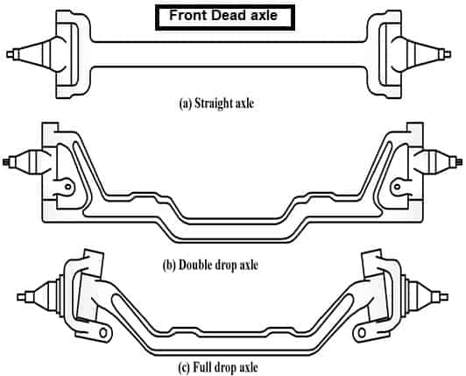

Slide 40
Axle Shaft
Types of axle shaft
Live (drive) axle
It drives the vehicle by transferring torque from the differential to each driving wheel.
Rear axles can also help carry the weight of the vehicle or even act as part of the suspension.
The shaft in a live axle assembly may or may not actually support part of the weight of a vehicle, but it does drive the wheels connected to it.

Slide 41
Axle Shaft
Types of axle shaft
Live(drive) axle cont..
A live axle is involved with steering when it is a front drive axle, Some live rear axles are also designed to steer.
The rear axle of conventional passenger vehicles is a live axle, while in a four-wheel drive vehicle both front and rear axles are live.
In some six-wheel vehicles, all three axles are live axles.

Slide 42
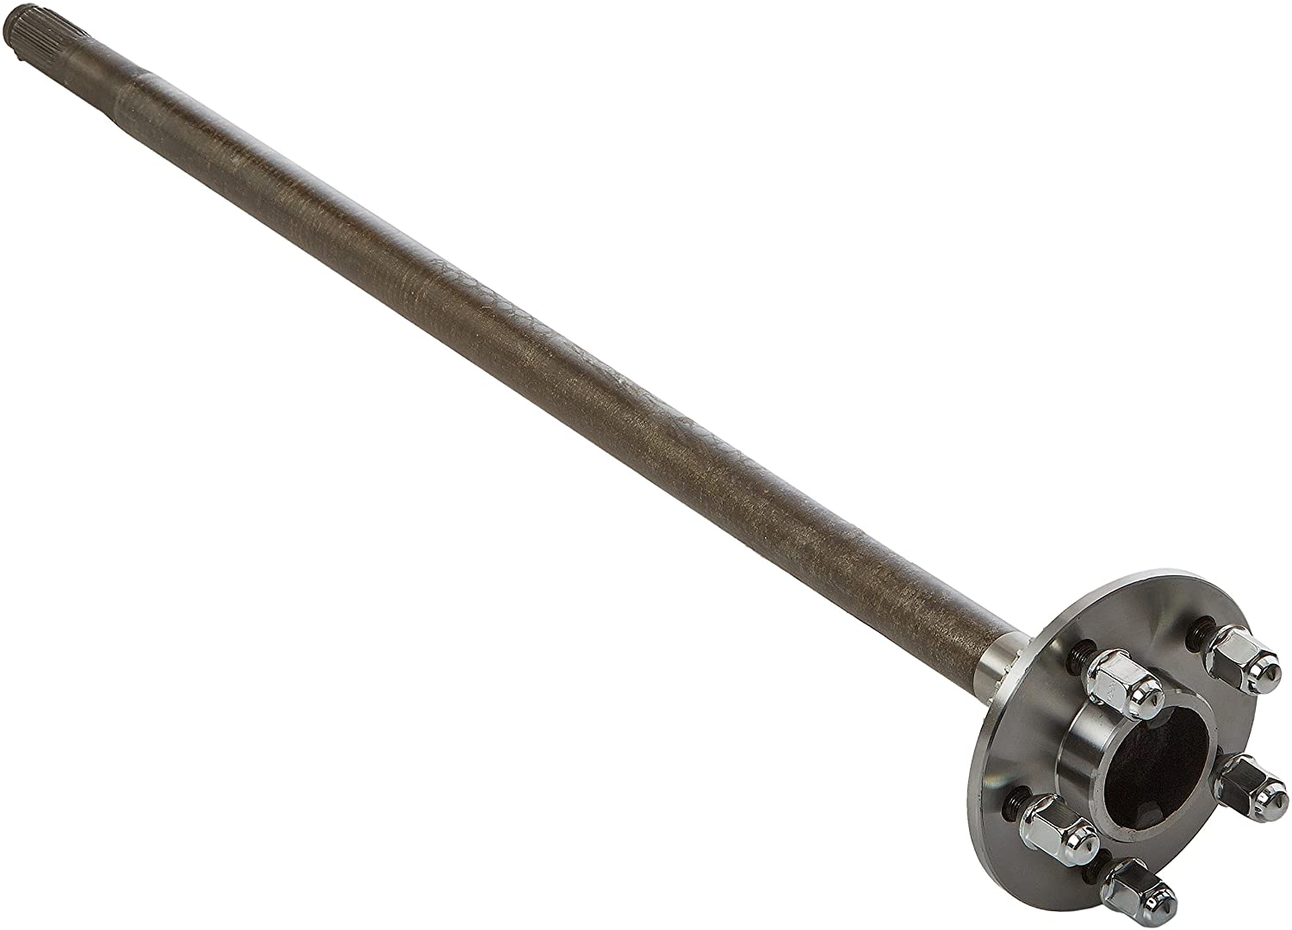

Slide 43
Axle Shaft
There are basically three designs by which axles are supported in a live axle
Full-floating
Three-quarter floating and
Semi-floating
These refer to where the axle bearing is placed in relation to the axle and the axle housing.

Slide 44
Axle Shaft
Designs by Which Axles are Supported in a Live Axle
Full-floating axle
The bearing is located on the outside of the axle housing.
This places all of the vehicle’s weight on the axle housing with no weight on the axle.
The drive wheel is carried on the outer end of the axle housing by a pair of tapered roller bearings.
The bearings are located outside the axle housing.

Slide 45
Axle Shaft
Designs by Which Axles are Supported in a Live Axle
Full-floating axle cont..
Axle housings take the full weight of the vehicle and absorb all stresses or end thrust caused by turning, skidding, and pulling.
Axle shaft transmits torque only from the differential.
Commonly found on heavy-duty trucks
The axle shaft is connected to the drive wheel through a bolted flange.
This allows the axle shaft to be removed for servicing without removing the wheel.

Slide 46
Axle Shaft
Designs by Which Axles are Supported in A Live Axle
Semi-floating
The axle shaft and the axle housing supports the weight of the vehicle.
The outer end is carried by a bearing located between the shaft and the housing.
A tapered roller of ball-type bearing transfers the load from the shaft to the housing.
The axle shafts take the stresses caused by turning, skidding, or wobbling of the wheels.
The axle shafts are flanged or tapered on the ends

Slide 47
Axle Shaft
Designs by Which Axles are Supported in a Live Axle
Three-quarter floating
Is a live axle in which the outer ends of the axle shaft are supported by wheels forming a rigid unit with the shaft .
The inner end of the axle is carried by the side gears in the differential housing
The wheels are fitted at the end of the shaft by means of the key
Weight of the vehicle is taken by axle and by axle housing but the major weight is taken by axle housing and not axle.

Slide 48
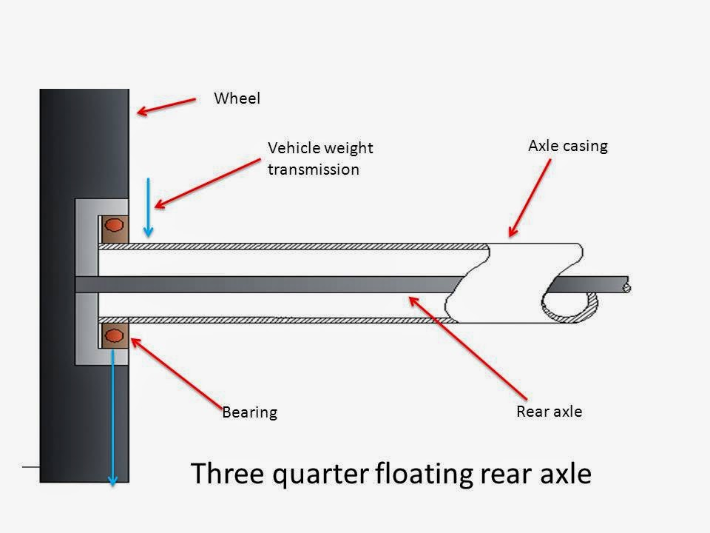
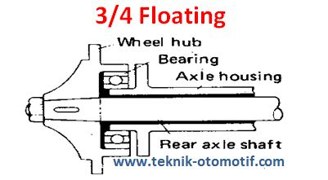

Slide 49
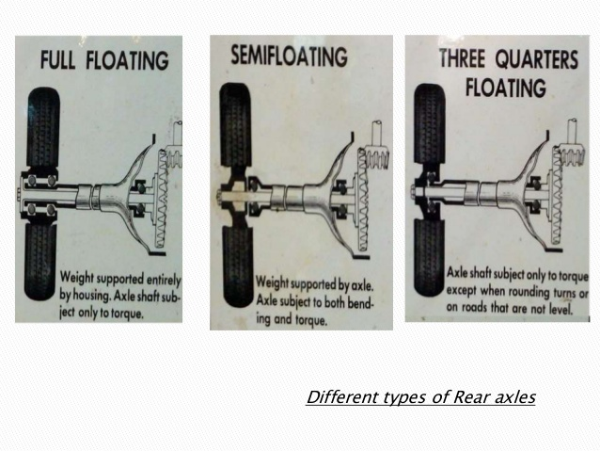

Slide 50
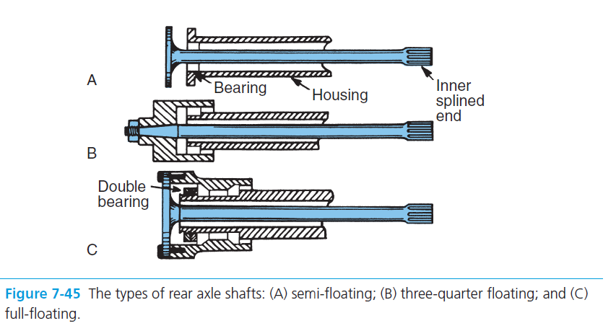

Slide 51
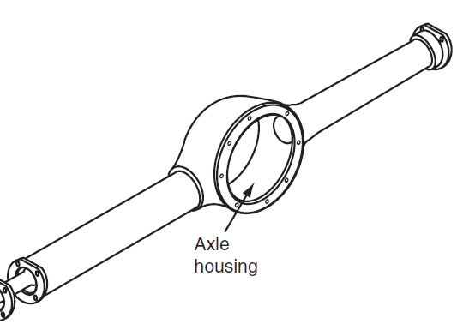
Axle Housings
Live rear axles use a one-piece housing with two tubes extending from each side.
These tubes enclose the axles and provide attachments for the axle bearings.
The housing also shields the parts from dirt and retains the differential lubricant

Slide 52
Transfer Case
A transfer case is a part of the drivetrain of four-wheel-drive, all-wheel-drive, and other multiple powered axle vehicles.
The transfer case transfers power from the transmission to the front and rear axles by means of drive shafts
The transfer case also allows the front driving axle to be engaged and disengaged and shifting must be done while the vehicle is not moving

Slide 53
Transfer Case
Another purpose of the transfer case is to move the drive shaft for the front driving axle off to the side so that it can clear the engine
This arrangement is necessary to allow adequate ground clearance and to allow the body of the vehicle to remain at a practical height.
Transfer case can be of
Gear Type Transfer Case
Chain Type Transfer Case

Slide 54
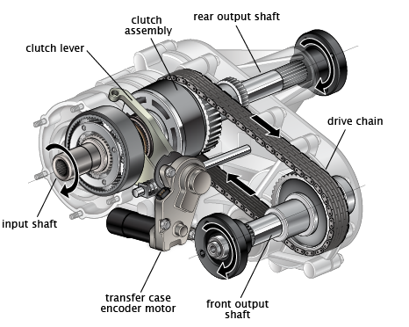
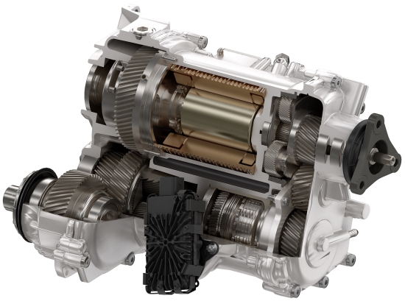
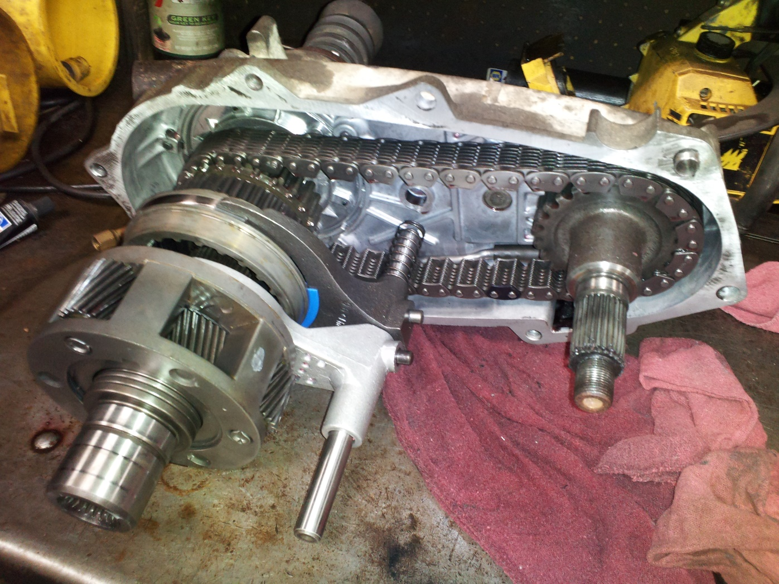

Slide 55
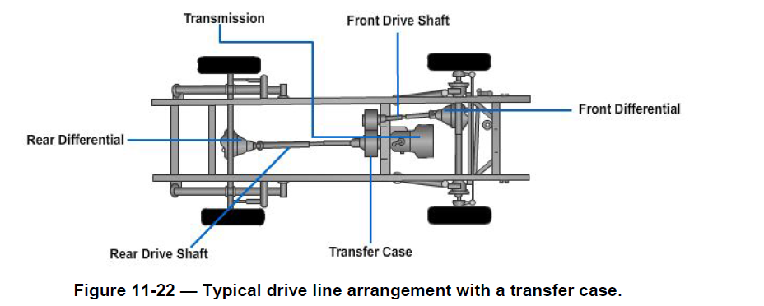

Slide 56
Four Wheel Drive (4WD)
To apply torque at more locations for improved traction on wet, uneven, or slippery surfaces, all four wheels can be driven.
Four-wheel drive vehicles require additional drivetrain parts to transmit torque to additional driving wheels.
4WD can be
Full time 4WD
Part time 4WD

Slide 57
Power Take Off
A power takeoff (PTO) is an attachment for connecting the engine to power-driven auxiliary equipment.
It is attached to the transmission or transfer case.
Most commonly, it is a splined drive shaft installed on a tractor or truck allowing implements with mating fittings to be powered directly by the engine

Slide 58
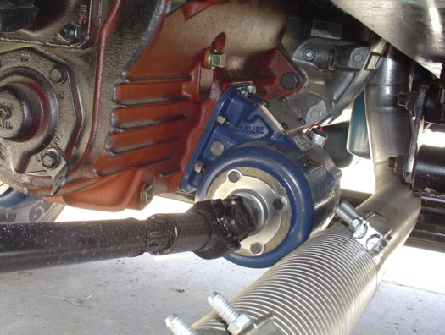
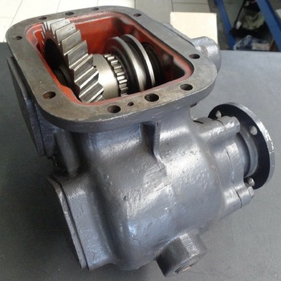

Slide 59
Service and Maintenance
Differential Lubricant Service
Many vehicle manufacturers recommend that the differential fluid be checked and replaced at specific intervals.
To check the fluid level in a differential, remove the filler plug, which is located either in the front or rear of the assembly.
The lubricant should be even with the fill hole when hot and slightly below the hole when cold.

Slide 60
Service and Maintenance
Differential Lubricant Service cont..
When the manufacturer recommends that the differential fluid be
replaced, remove the drain plug located on the bottom of the differential housing.
With all the fluid drained, replace the drain plug and refill with the proper lubricant.
NOTE
Always install the correct type of differential lubricant. Limited slip
differentials often require a special type of lubricant for the friction
clutches.

Slide 61
Service and Maintenance
Axle Service
Rear axle service is needed when an axle bearing is noisy, when an axle is broken, bent, or damaged, or when an axle seal is leaking.
The rear axles must be removed to allow removal and repair of the differential assembly.

Slide 62
Service and Maintenance
When diagnosing and repairing bearing failures, do the following:
Check the general condition of all parts during disassembly, not just the most badly worn or damaged parts.
Compare the failure to any added information in the service manual and your knowledge of the component’s operation.
Determine the causes of the part failure. This helps in assuring that the problems do NOT reoccur.
Perform all repairs following the manufacturer’s recommendations and specifications

Slide 63
Thank You

